Slide 1
Cyclistic Annual Members vs Casual Riders
Google Data Analytics Capestone: Case Study
Presented by: Biswabal Gurung
Last Updated: July 9th, 2022

Slide 2
Cyclistic Annual Members vs Casual Riders
Table of Contents
Objective
Findings
Recommendations

Slide 3
Objective
Understand how do annual members and casual riders use bike-share program differently in order to design marketing strategies aiming to convert Cyclistic casual riders into annual members.

Slide 4
Findings

Slide 5

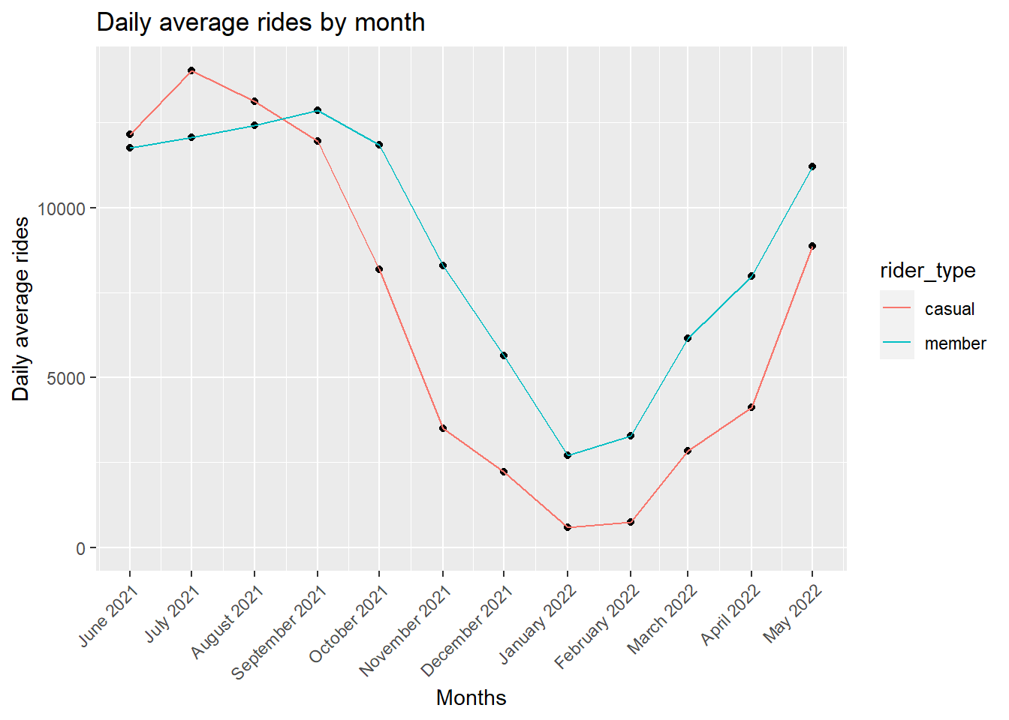



Variation of daily average rides by month
Both members and casual riders tend to ride bikes more during summer.
More number of casual riders during summer.
Further analysis required to identify trends over years.

Slide 6

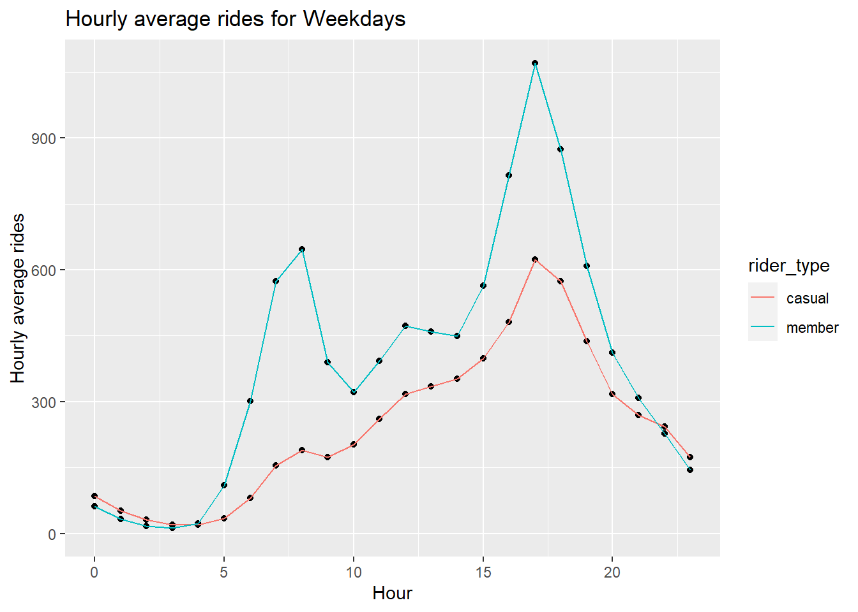
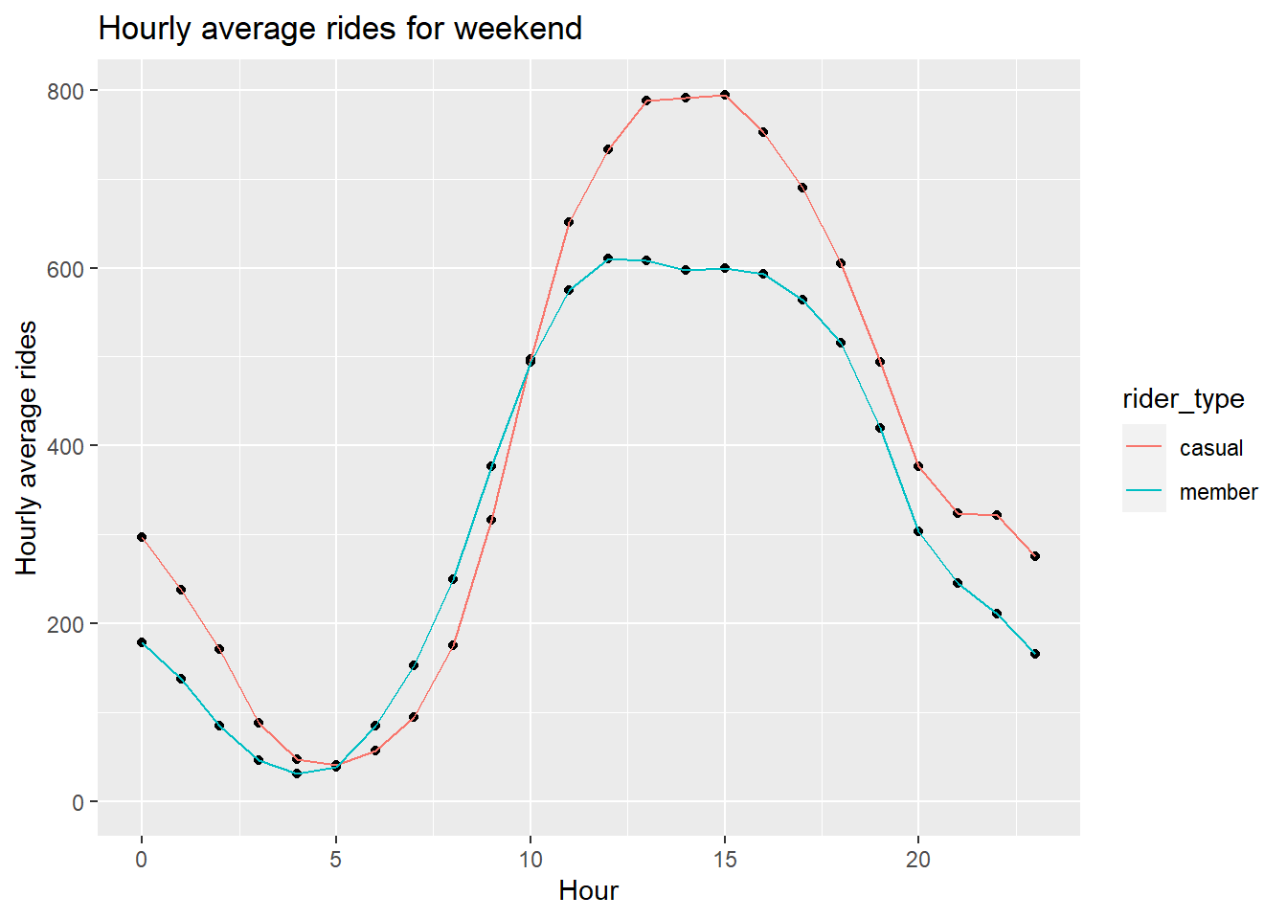
Variation of hourly average rides during weekday and weekends
Similar pattern of bike use during weekdays between 5 am – 9 pm between members and casual riders.
Members are active during weekdays. 5 pm – 6 pm is the most active hour.
Casual riders are more active during weekends. 11 am – 6 pm is the most active hour.

Slide 7
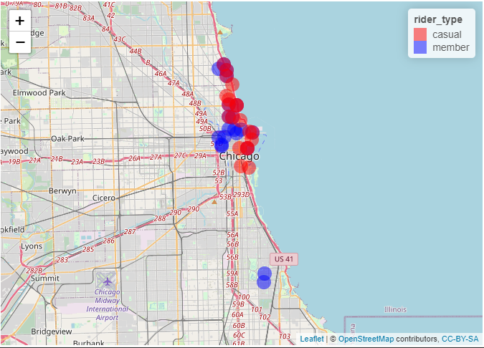
Top 20 popular stations
Casual riders ride within the city of Chicago.
Members tend to ride within as well as outside the city.
Many students of University of Chicago uses bike to commute to campus and are members.

Slide 8
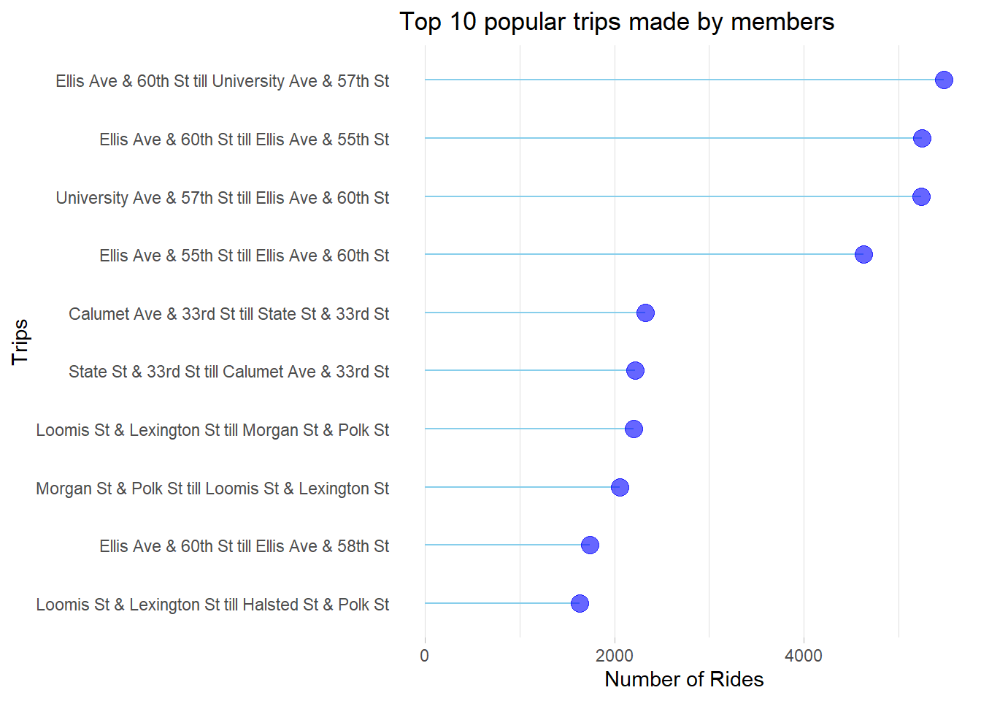
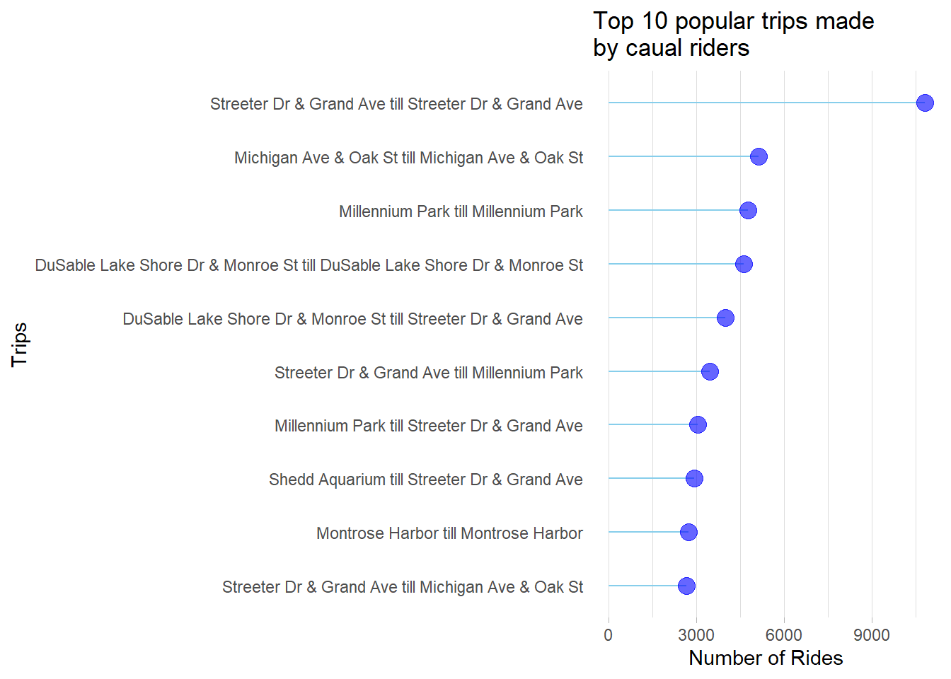
Top 10 popular trips among members and casual riders
Top 4 trips made by members are close to University of Chicago.
Top 4 trips made by casual riders starts and ends at the same station, which indicates they ride for leisure rather than to commute.

Slide 9
Recommendations

Slide 10
Offer discounted membership during summer.
Send push notification to casual riders who rides on weekdays to commute.
Offer student discounted membership.

Slide 11
Thank You

